Slide 1
Dialogue Systems
Advanced NLP
Suyi Li
Oct, 2018

Slide 2
Outline
Introduction & Background
Basic Concepts & Motivation
Categories
Recent Trends
Presentation of paper 1 --- <Global-Locally Self-Attentive Dialogue State Tracker>
Presentation of paper 2 --- <Learning to Map Context-Dependent Sentence to
Executable Formal Queries>
Presentation of paper 3 --- <Sequicity: Simplifying Task-oriented Dialogue Systems with
Single Sequence-to-Sequence Architectures>
Presentation of paper 4 --- <End-to-End Learning of Task-Oriented Dialogs>
Discussion questions
References

Slide 3
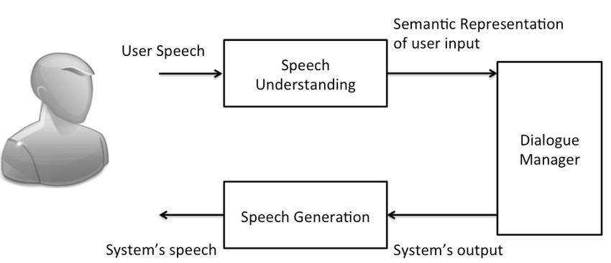
What are Dialogue Systems
A dialogue system is a computer system intended to converse with a human with a coherent structure.
Automatic human - computer conversation system
Work as our personal assistant or chat companion
https://www.researchgate.net/figure/Spoken-dialogue-system-architecture_fig2_306091536
Notes:
Let us begin with the basic concepts.
Generally speaking, Dialogue system is a computer system that intended to converse with a human with a coherent structure.
It is an automatic human-computer conversation system and work as personal assistant and chat companion.
The picture shown here is a general architecture of the a dialogue system. Three main parts of this system are Speech Language Understanding module, Dialogue Manager and Speech Generation module.
The user utterance goes into the SLU module and the system response is generated from the speech generation module.

Slide 4
Why Dialogue Systems
Dialogue Systems solve many problems:
Question Answering:
The system needs to provide concise, direct answers to user queries based on rich knowledge drawn from various data sources.
Task Completion:
The system needs to accomplish various user tasks ranging from restaurant reservation to meeting scheduling.
Social Chat:
The system needs to converse seamlessly and appropriately with users like a human as measured by the Turing test.
Notes:
The research area of dialogue system is receiving more and more attention recently.
So why dialogue system is meaningful ? Because research on Dialogue System could solve many practical problems, like Question Answering, Task Completion and Social Chat.
For question answering, the system needs to provide concise, direct answers to user queries based on rich knowledge from external data sources.
For task completion, the system needs to accomplish user tasks ranging from restaurant reservation to meeting scheduling.
And for social chat, the system needs to converse seamlessly and appropriately with users like a human.

Slide 5
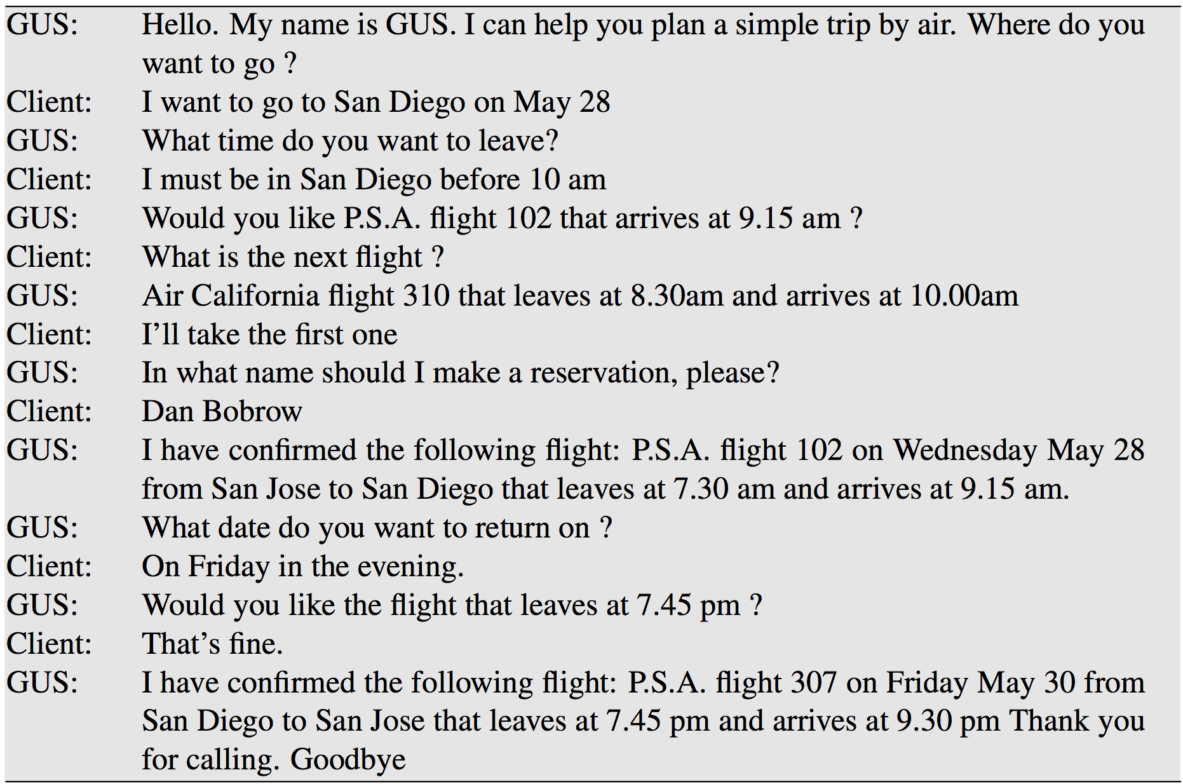
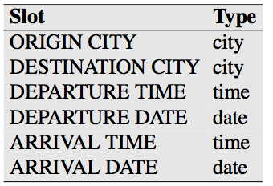
Why Dialogue Systems
Dialogue Systems
support a broad range of applications:
The travel domain: A transcript of an actual dialog with the GUS system of [ Bobrow et al. 1977]
Notes:
Based on the abilities to solve various kinds of problems, the dialogue system could support a broad range of applications.
This figure shows a conversation with the original GUS system, which a frame-driven dialog system.
Some modern task-based dialog systems are based on a domain ontology, which is a knowledge structure representing the kinds of intentions the system can extract from user sentences.
The ontology defines one or more frames, each with a collection of slots, and a slot defines the values that each slot can take.
The set of slots in a GUS-style frame specifies what the system needs to know, and the filler of each slot is constrained to values of a particular semantic type.
In the travel domain, for example, a slot might be of type city (hence take on values like San Francisco, or Hong Kong) or of type date, airline, or time.
This picture introduces the types used in the GUS system.

Slide 6
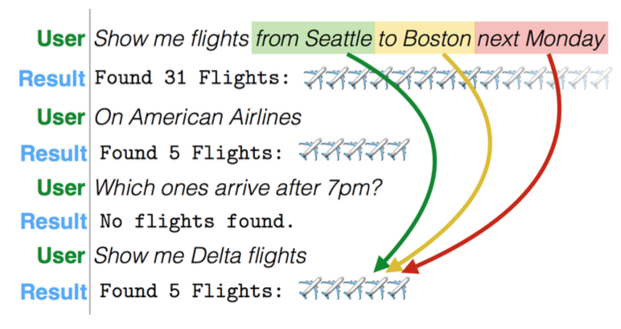
Why Dialogue Systems
Dialogue Systems
support a broad range of applications:
An excerpt of an interaction from the ATIS flight planning system [Hemphill et al., 1990; Dahl et al., 1994 ]
Notes:
This picture shows an example of an interaction from the ATIS flight planning system.
Based on the semantic parsing and dialogue system, the dialogue system could provide help for travelers.
Based on the interaction history and current user utterance, the system shrink the search range and give more precise solutions to travelers.

Slide 7
Why Dialogue Systems
Dialogue Systems support a broad range of applications:
Task-oriented application:
Apple Siri: Siri is an intelligent assistant that offers a faster, easier way to get things done on your Apple devices.
Google Home: Google Home speakers enable users to speak voice commands and provide support for home automation
Non-task-oriented application:
Microsoft XiaoIce: Microsoft's XiaoIce is an AI bot that can also converse like a human with “full duplex voice sense”
Notes:
Based on the power of dialogue system research, many applications come out.
Generally speaking, there are two kinds of applications, namely task-oriented applications and non-task-oriented applications.
For task-oriented applications, they can only handle relatively simple tasks, such as reporting weather and requesting songs.
Applications, such as Apple Siri, which is an intelligent assistant that offers a faster, easier way to get things done on your Apple devices.
And for google home, it enables users to speak voice commands and provide support for home automation.
For non-task-oriented applications, which is also called chat bot.
It is a computer program or an artificial intelligence which conducts a conversation with human smoothly via auditory or textual methods.
One of the application is Microsoft XiaoIce, arguably the most popular commercial social chatbot that has attracted more than 660 million users worldwide.
It can converse like a human with “full duplex voice sense”, which refers to the ability to communicate in both directions simultaneously, like a phone call. While user is speaking, system could predict what user gonna speak at the same time.

Slide 8

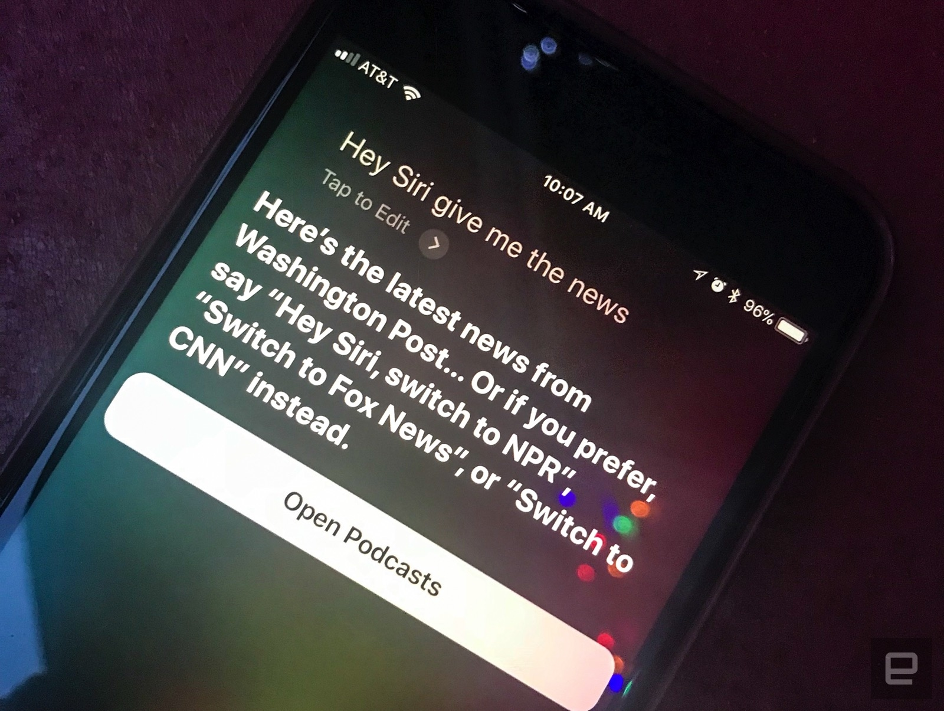

Some Examples
https://www.engadget.com/2018/01/03/apple-adds-siri-powered-news-briefing-ios-beta/
https://store.google.com/us/product/google_home
https://mspoweruser.com/unlike-tay-microsofts-chinese-ai-bot-knows-how-to-deal-with-racist-comments/
Notes:
Here are some picture example of the applications.
Apple Siri, Google Home and Microsoft XiaoIce

Slide 9
Feasibility of Dialogue Systems
Easily Access "Big Data"
Conversation data is generated every second
Conversation data on the Web is available to train
Techniques
Deep learning techniques are effective in capturing complex patterns in big data
Natural Language Understanding deals with comprehension
Notes:
Dialogue system seems to be a really amazing artificial intelligence technology. So, is it feasible to implement it? The answer is "Yes".
With the development of big data and deep learning techniques, the goal of creating an automatic human computer conversation system, as our personal assistant or chat companion, is no longer an illusion.
On the one hand, nowadays we can easily access “big data” for conversations on the Web and the system might be able to learn how to respond and what to respond given (almost) any inputs, which greatly allows us to build data-driven, open-domain conversation systems between humans and computers.
On the other hand, deep learning techniques have been proven to be effective in capturing complex patterns in big data and have powered numerous research fields such as computer vision, natural language processing
So, combine the huge amount of data and the deep learning techniques, building a dialogue system is possible.

Slide 10
Categories of Dialogue Systems
Task-oriented systems
Focus on a limited domain
Aim to assist the user to complete certain tasks (e.g. querying information, or taking actions)
Non-task-oriented systems (aka. chat bots)
Focus on open domain conversation
Usually interact with human to provide reasonable responses and entertainment
Notes:
The categories of the dialogue system can be generalized into two categories: task-oriented dialogue systems and non-task-oriented systems.
Task-oriented systems aim to assist the user to complete certain tasks.
Non-task-oriented dialogue systems, also called chatbot, interact with human to provide reasonable responses and entertainment.

Slide 11
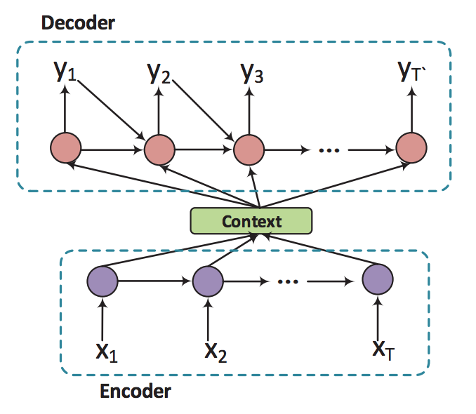
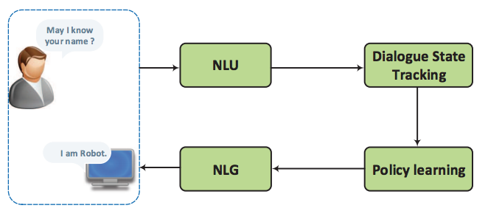
Categories of Dialogue Systems
Task-oriented systems
Traditional Pipeline for Task-oriented Systems
From [Chen et al., 2018]
An Illustration of the Encoder-Decoder Model
From [Chen et al., 2018]
Notes:
The widely applied approaches to task-oriented systems are to treat the dialogue response as a pipeline as shown in Figure.
The systems first understand the message given by human, represent it as an internal state, then take some actions according to the policy with respect to the dialogue state, and finally the action is transformed to its surface form as a natural language.
In addition, there are attempts to build end-to-end task-oriented dialogue systems, which can expand the state space representation in the traditional pipeline systems and help generalize dialogues outside the annotated task-specific corpora.

Slide 12
Categories of Dialogue Systems
Non-task-oriented systems
Neural Generative Methods: generative methods, such as seq-to-seq models, which generate proper responses during the conversation;
Example: Phrase-based Statistical Machine Translation [R. Zens et al., 2002], to model conversations on micro-blogging
Retrieval-based Methods: retrieval-based methods, which learn to select responses from the current conversation from a repository
Example: [Hu et al. 2014] used DNN network architecture to learn the representation of message and candidate response to calculate matching score
Notes:
For non-task-oriented dialogue systems, they interact with human to provide reasonable responses and entertainment.
Typically, they focus on conversing with human on open domains. In general, two major approaches have been developed for non-task-oriented systems –
(1) generative methods such as sequence-to-sequence models, which generate proper responses during the conversation; and
(2) retrieval-based methods, which learn to select responses from the current conversation from a database.
Generative models are able to generate more proper responses that could have never appeared in the corpus,
while retrieval-based models enjoy the advantage of informative and fluent responses, because they select a proper response for the current conversation from a database with response selection algorithms.

Slide 13
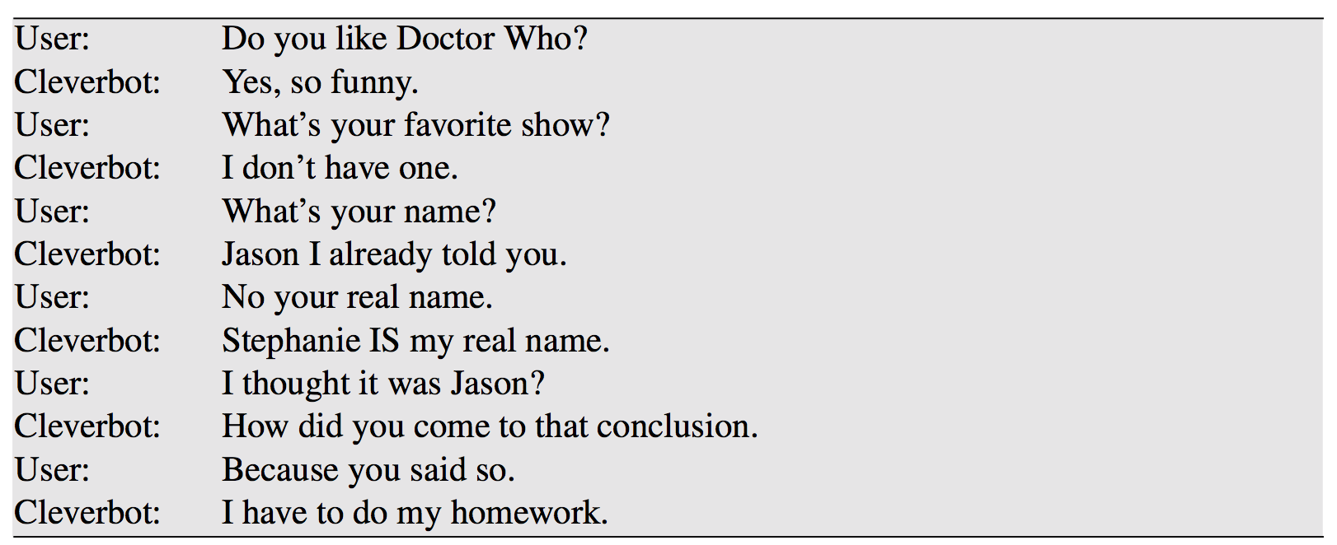
Categories of Dialogue Systems
Non-task-oriented systems
A conversation between a user and a Cleverbot, an IR-based chatbot [Carpenter, 2017]
Notes:
This is a example conversation between a user and a chatbot. It interact with human to provide reasonable responses and entertainment

Slide 14
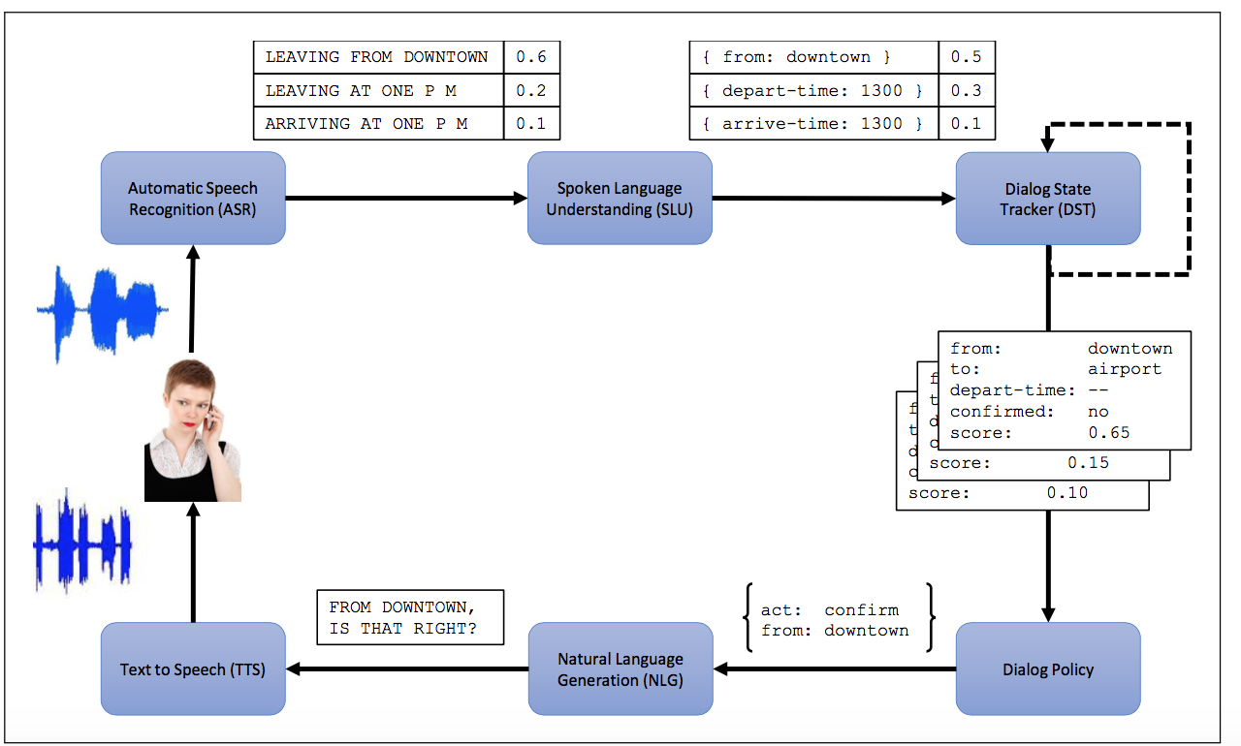
Recent Research on Dialogue Systems
Architecture of a dialogue-state system [William et al. 2016]
Notes:
In the next few slides, I will introduce some most recent research on the dialogue system.
This picture shows a typical recent proposed architecture for a dialog system. It has six components.
The speech recognition and understanding components extract meaning from the input, and
the generation and TTS components map from meaning to speech.
The parts that are different from previously mentioned simple GUS system are the dialog state tracker which maintains the current state of the dialog (which include the user’s most recent dialog act, plus the entire set of slot-filler constraints the user has expressed so far) and the dialog policy, which decides what the system should do or say next.
// The most important two part that need to pay attention to is dialog state tracker, dialog policy.

Slide 15
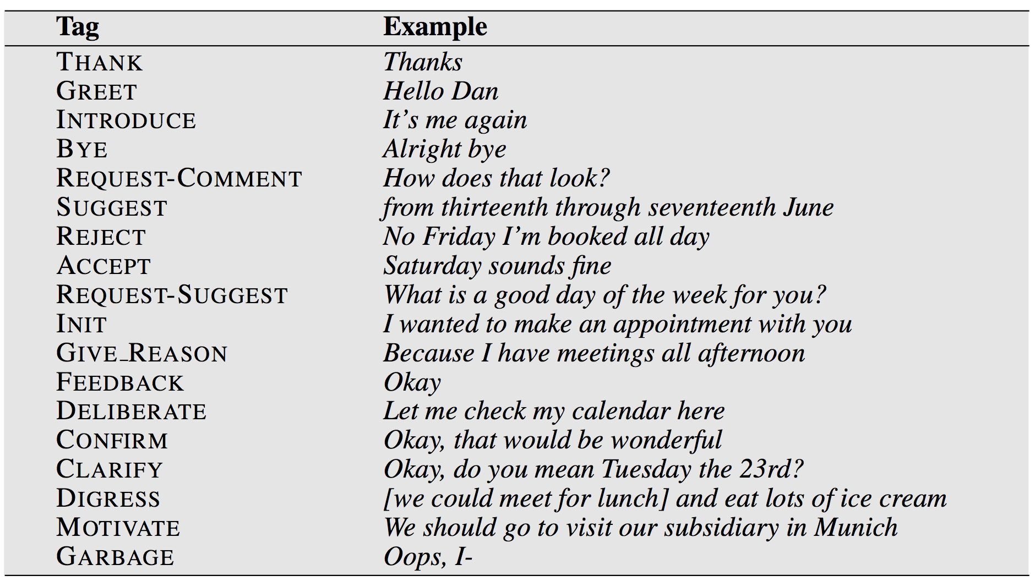
Recent Research on Dialogue Systems
Dialogue Act
A dialog act is a tag which represents the interactive function of the sentence being tagged.
The 18 high-level dialog acts for a meeting scheduling task, from the Verbmobil-1 system [Jakat et al. 1995]
Notes:
Let us look at the dialog act.
A dialog act is a tag which represents the interactive function of the sentence being tagged.
The figure shows a domain-specific tag set for the task of two people scheduling meetings.
It has tags specific to the domain of scheduling, such as SUGGEST, used for the proposal of a particular date to meet, and ACCEPT and REJECT, used for acceptance or rejection of a proposal for a date, but also tags that have more general function, like CLARIFY, used to request a user to clarify an ambiguous proposal.

Slide 16
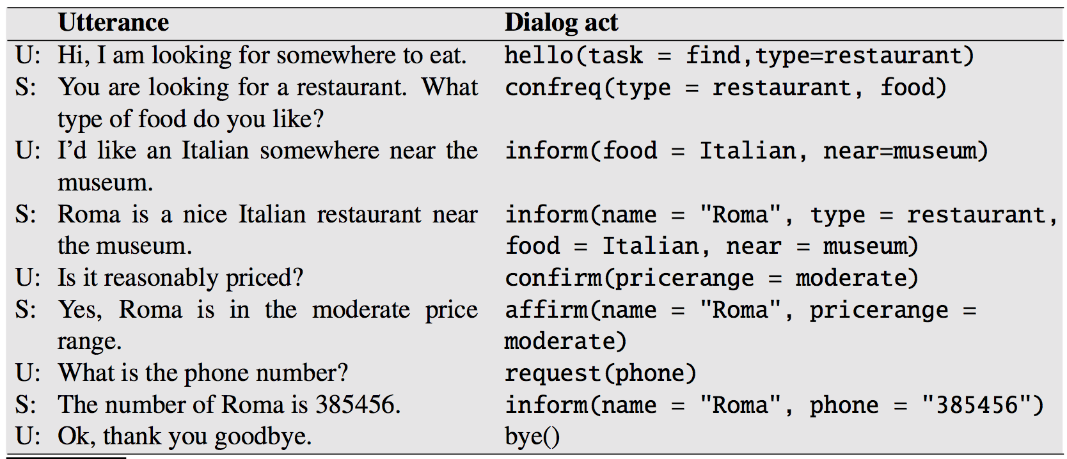
Recent Research on Dialogue Systems
Another Example of Dialogue Act
A sample dialog from the HIS System of [Young et al. 2010]
Notes:
This figure shows some tags labeling a sample dialog from the HIS system.
This example also shows the content of each dialog acts, which are the slot fillers being communicated.
The dialogue happens in a restaurant recommendation system.

Slide 17
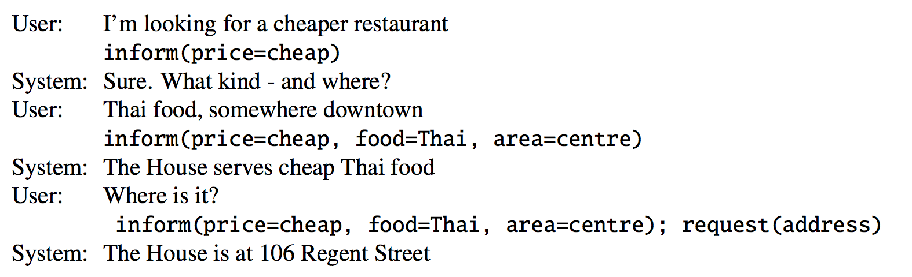
Recent Research on Dialogue Systems
Dialogue State: Interpreting Dialog Acts
A dialog state includes the entire state of the frame at a certain point, summarizing all of the user’s constraints.
Dialog State Tracker Example from [Mrksˇic ́ et al. 2017]
Notes:
Dialog state is proposed to interpret dialog acts.
A dialog state includes more than just the slot-fillers expressed in the current sentence but also includes the entire state of the frame at a certain point, summarizing all of the user’s constraints.
The picture here shows the required output of the dialog state tracker after each turn. (讲图)

Slide 18
Recent Research on Dialogue Systems
Sketching an algorithm for dialog act interpretation
Consider the task of determining that:
I’d like Cantonese food near the Mission District.
has the structure:
inform(food=cantonese, area=mission)
Begin with a first pass classifier to decide on the dialog act for the sentence.
A second pass classifier use sequence-model algorithms for slot-filler extraction.
Notes:
Since dialog acts places some constraints on the slots and values, the tasks of dialog act detection and slot-filling are often performed jointly. Consider the task of determining that:
I’d like Cantonese food near the Mission District
has the structure
inform(food=cantonese, area=mission)
The joint dialog act interpretation/slot filling algorithm generally begins with a first pass classifier to decide on the dialog act for the sentence.
In the case of the example above, this classifier would choosing inform among the possible dialog acts in the tag set for this particular task. Dialog act interpretation is generally modeled as a supervised classification task, trained on a corpus in which each utterance is hand-labeled for its dialog act.
A second pass classifier might use the sequence-model algorithms for slot-filler extraction, such as a joint LSTM-CRF. Alternatively, a multinomial classifier can be used to choose among all possible slot-value pairs.

Slide 19
Recent Research on Dialogue Systems
Dialog Policy
Policy Learning takes dialogue state as input and outputs system action as output.
Dialogue Policy Learning can be modelled as a Reinforcement Learning (Sutton and Barto, 1998) problem
Dialogue states can be modeled by Markov Decision Process {𝑆, 𝐴, 𝑃, 𝑅, 𝛾}
The objective is to maximize Cumulative Reward
Notes:
The goal of the dialog policy is to decide what action the system should take next, that is, what dialog act to generate.
Policy Learning takes dialogue state as input and outputs system action.
Dialogue Policy Learning can be modelled as a Reinforcement Learning problem.
The dialog states can be model by Markov Decision Process and
the objective is to maximize the Cumulative Reward.

Slide 20
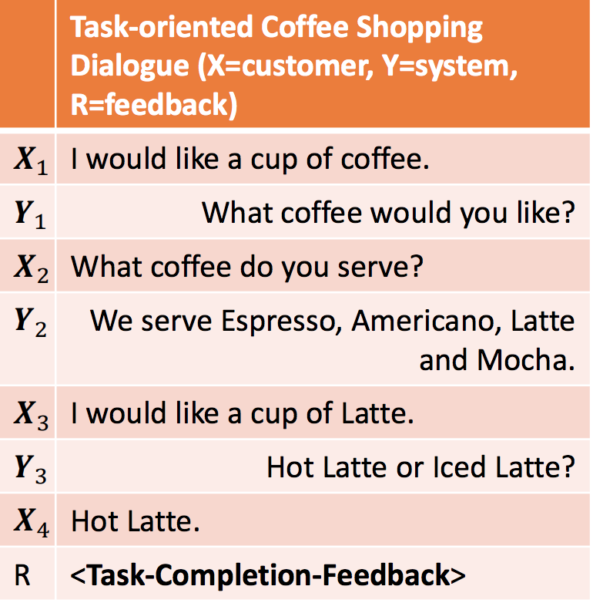
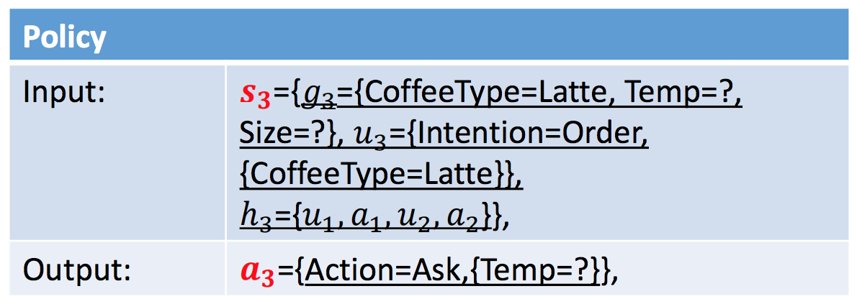
Recent Research on Dialogue Systems
Dialog Policy Example
A coffee shopping dialogue example [Mo 2017]
Notes:
This is a figure show how and where the dialog policies work. (讲图)

Slide 21
Recent Research on Dialogue Systems
Natural Language Generation
Natural Language Generation takes system action as input and outputs system response.
Dialogue action 𝑎𝑛 = {𝑑𝑛, {𝐴𝑖 , 𝑉𝑖} }, 𝑑𝑛 is the dialogue act type and 𝐴𝑖 , 𝑉𝑖 are the name and value of the 𝑖-th attribute.
𝒀𝑛 = {𝑦1, 𝑦2, … } is the list of words in the 𝑛-th response
Notes:
The next part is natural language generation.
Natural Language Generation module takes system action as input and outputs system response.
A dialog action can be expressed as this, where 𝑑𝑛 is the dialogue act type and 𝐴𝑖 , 𝑉𝑖 are the name and value of the 𝑖-th attribute.
And based on the Natural Language Generation algorithms, such as corpus based sentence generation, sentence planning and surface realization, neural network based sentence generation and so on, we could generate a list of words as response.

Slide 22
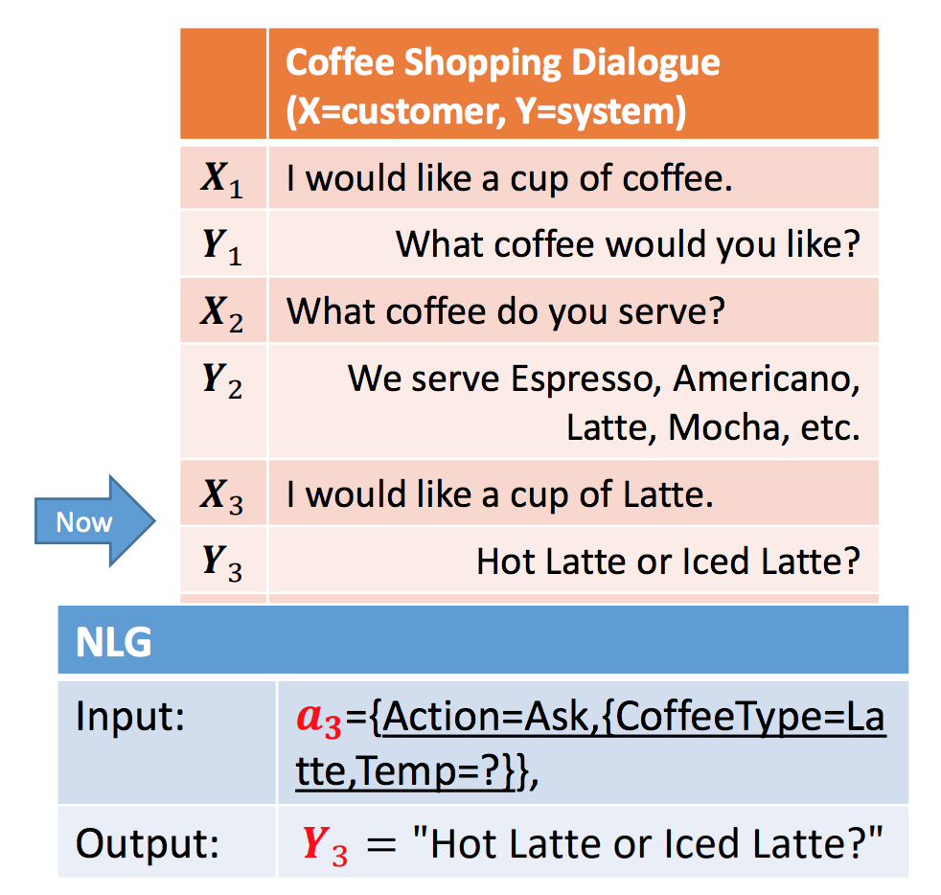
Recent Research on Dialogue Systems
Natural Language Generation Example
A coffee shopping dialogue example [Mo 2017]
Notes:
This is an example dialog, which illustrates the process of natural language generation.

Slide 23
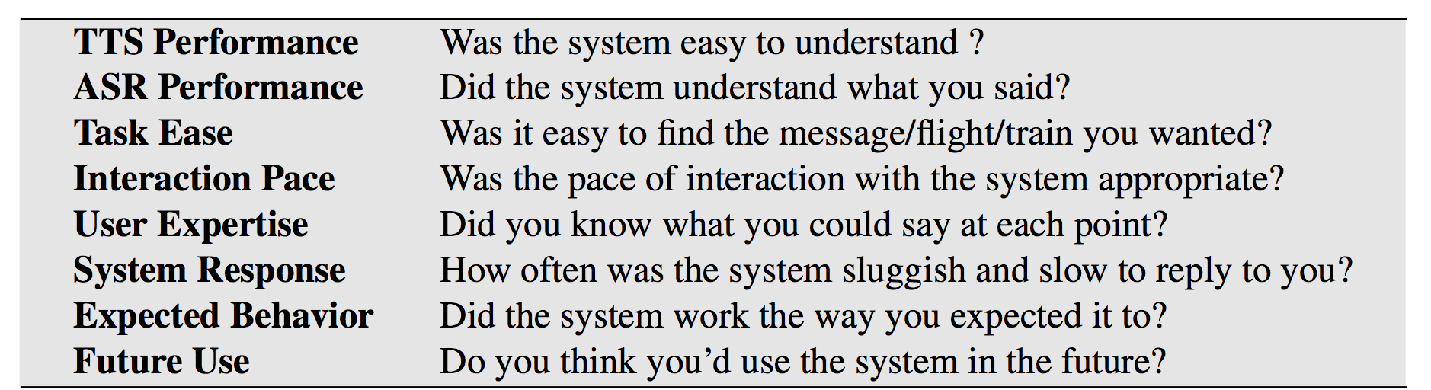
Evaluating Dialogue Systems
User satisfaction rating
User satisfaction survey [Walker et al. 2001]
Notes:
Next, let us talk about evaluating a dialog system.
Evaluation is crucial in dialog system design. If the task is unambiguous, we can simply measure absolute task success (did the system book the right plane flight, or put the right event on the calendar).
To get a more fine-grained idea of user happiness, we can compute a user satisfaction rating, having users interact with a dialog system to perform a task and then having them complete a questionnaire.
For example, this figure shows sample multiple-choice questions; responses are mapped into the range of 1 to 5, and then averaged over all questions to get a total user satisfaction rating.

Slide 24
Recent Trends
Incorporate EQ (or Empathy) into Dialogue
Incorporate Common Sense Knowledge into Dialogue
Incorporate Model Interpretability
Incorporate Privacy Protection
Notes:
Next, I would like to introduce some recent trends of the dialogue system research.
The first one is to Incorporate EQ (or Empathy) into Dialogue. This is useful for both chatbots and QA bots. For example, XiaoIce incorporates an EQ module so as to deliver a more understandable response or recommendation. Dialogue systems embedded an empathy module into a dialogue agent will be able to recognize users’ emotion, and generate emotion-aware responses.
The second one is to incorporate Common Sense Knowledge into Dialogue. Common sense has been introduced in the previous presentation before. Common sense is crucial for any dialogue agents. But it is challenging because common sense knowledge is often not explicitly stored in existing knowledge base. So, new datasets are needed to be developed to foster the research on common sense reasoning.
The third one is to incorporate Model Interpretability. In some cases, a dialogue agent is required not only to give a recommendation or an answer, but also provide explanations. This is very important in e.g., business scenarios, where a user cannot make a business decision without justification.
The fourth one is to incorporate privacy protection into the dialogue systems,. Widely applied dialogue system serves a large number of people. It is quite necessary to notice the fact that we are using the same dialogue assistant. With the ability of learning through interactions, comprehension and inference, a dialogue assistant can store some of sensitive information. Hence, it is important to protect users’ privacy while building better dialogue systems.

Slide 25
Papers Covered Today
Dialogue State Tracker:
Global-Locally Self-Attentive Dialogue State Tracker, 2018
Dialogue to Query:
Learning to Map Context-Dependent Sentence to Executable Formal Queries, 2018
Task-oriented Dialogue Systems:
Sequicity: Simplifying Task-oriented Dialogue Systems with Single Sequence-to-Sequence Architectures, 2018
End-to-End Learning of Task-Oriented Dialogs, 2018
Notes:
Next, I will move to introduce the paper covered in the class.
The first one is “Global-Locally Self-Attentive Dialogue State Tracker”, which focus on the dialogue state tracking.
The second one is “Learning to Map Context-Dependent Sentence to Executable Formal Queries”, which focus on dialogue understanding and map the user utterance in the dialogue to structured queries.
The third one “Simplifying Task-oriented Dialogue Systems with Single Sequence-to-Sequence Architectures”, which focus on simplifying the seq2seq dialogue system architecture with their proposed framework.
The last one is “End-to-End Learning of Task-Oriented Dialogs”, which also focus on the developing end-to-end task-oriented dialogs.

Slide 26
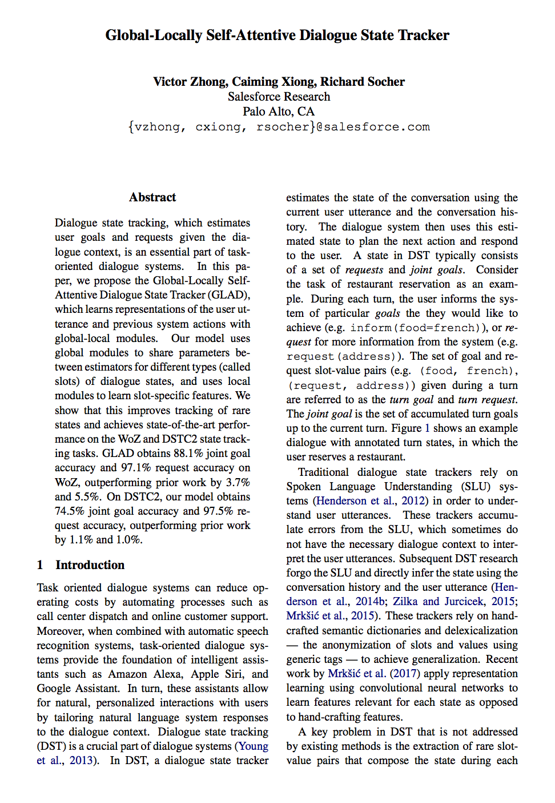
Paper 1: Dialogue State Tracker
Global-Locally Self-Attentive Dialogue State Tracker
Victor Zhong, Caiming Xiong, Richard Socher (ACL 2018)
“In this work, we propose the Global-Locally Self-Attentive Dialogue State Tracker (GLAD), a new state-of-the-art model for dialogue state tracking. In contrast to previous work that estimate each slot-value pair independently, GLAD uses global modules to share parameters between estimators for each slot and local modules to learn slot-specific feature representations. We show that by doing so, GLAD generalizes on rare slot-value pairs with few training examples. GLAD achieves state-of-the-art results of 88.1% goal accuracy and 97.1% request accuracy on the WoZ dialogue state tracking task (Wen et al., 2017), outperforming prior best by 3.7% and 5.5%. On DSTC2 (Henderson et al., 2014a), we achieve 74.5% goal accuracy and 97.5% request accuracy, outperforming prior best by 1.1% and 1.0%.
Notes:
The first paper presented in the class today is “Global-Locally Self-Attentive Dialogue State Tracker”. This paper concluded some research work on the Dialogue State Tracker.
They proposed a dialogue state tracking model, which is a new state-of-the-art model for dialogue state tracking.

Slide 27
Motivation
Background:
Task-oriented dialogues cover large state spaces, many slot value pairs that compose the state rarely occur in the training data. Failure to predict these rare slot-value pairs result in incorrect turn-level goal and request tracking.
Proposal:
Solve the problem of extraction of rare slot-value pairs that compose the state during each turn by proposing Global-Locally Self-Attention Dialogue State Tracker, a new state-of-art model for dialogue state tracking
Notes:
Let us move to the motivation part of this paper.
The background of the problem is that, many slot value pairs that compose the state rarely occur in the training data. Therefore, failure to predict these rare slot-value pairs result in incorrect turn-level goal and request tracking.
Therefore, to solve the problem of extraction of rare slot-value pairs that compose the state during each turn, the paper proposed Global-Locally Self-Attention Dialogue State Tracker, a new state-of-art model for dialogue state tracking.

Slide 28
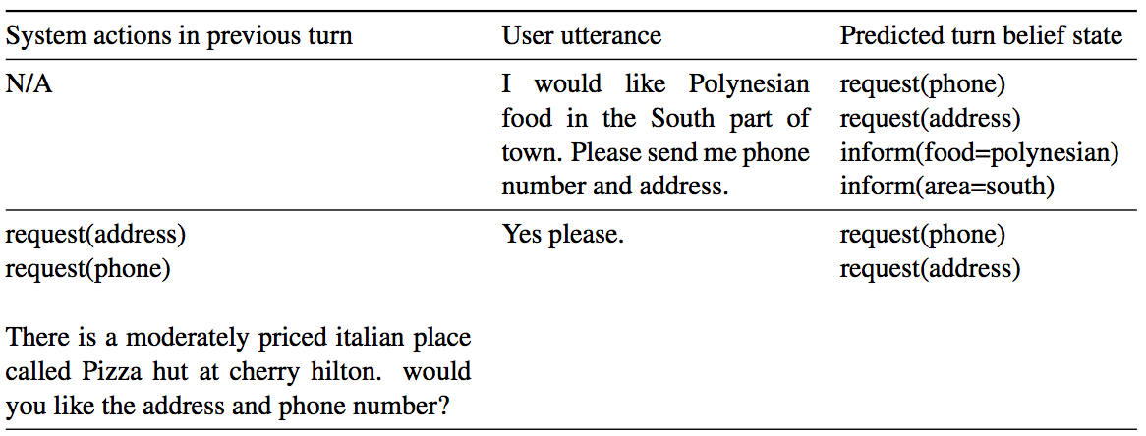
Motivation
slot-value pairs that compose the state during each turn
Notes:
This is a picture which shows the workflow of a dialogue system.
A turn in the dialogue system contains an user utterance, followed by corresponding turn-level goals and requests.
The system then executes actions, and formulates the result into a natural language response based on the extracted information.

Slide 29
Idea
Previous Work: Estimate each slot-value pair independently.
Model in Paper: GLAD uses global modules to share parameters between estimators for each slot and local modules to learn slot-specific feature representations.
Notes:
Previously, the dialogue state tracker used to estimate the slot-value independently.
However, GLAD proposed to build two modules, namely global modules and local modules. The model uses global modules to share parameters between estimators and local modules to learn slot-specific feature representations.

Slide 30
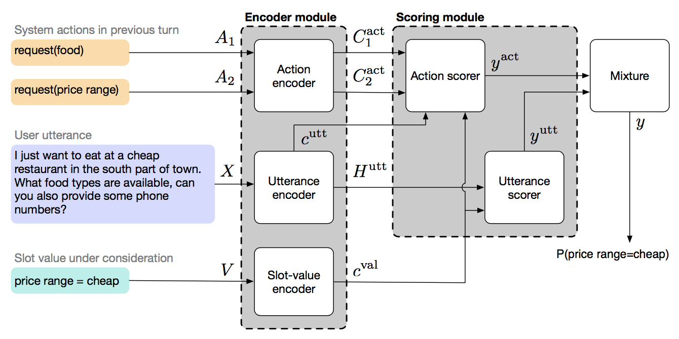
Model
Notes:
The overview of the model architecture is shown on the picture..

Slide 31
Model
1
2
Notes:
The model mainly have two parts, encoder and scoring module. The input of the encoder is user utterances, previous system actions and considered slot-value pairs,
The output of the encoder will serve as the input of the scoring part

Slide 32
Encoder
Global Modules: Model rare slot-value pairs by sharing parameters between each slot through global modules
Local Modules: Learning slot-specific features
Notes:
Next, let us look into each part of the model. As mentioned before, there are two modules in the model.
Generally speaking,
The global module models rare slot-value pairs by sharing parameters between each slot through global modules.
And the local module is responsible to learn slot-specific features.

Slide 33
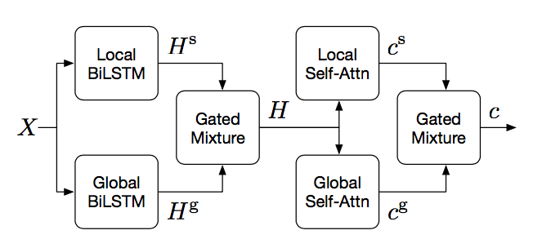
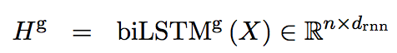
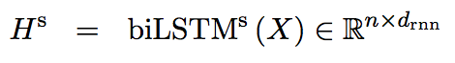
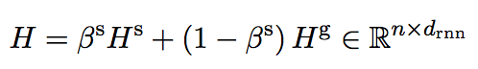
Encoder Module
Consider the process of encoding a sequence with respect to a particular slot s, the global-local encoding H of input X is shown as following:
1)
2)
3)
Notes:
(图片)The encoder consists of a bidirectional LSTM, which captures temporal relationships within the sequence, followed by a self-attention layer to compute the summary of the sequence.
Given a user utterance sequence X and a particular slot s, the global-local encoding H of input X is calculated and shown as on the slides.
( Let n denote the number of words in the sequence, d means the embedding dimension of the embeddings, )
Then global encoding and local encoding of X could be produced using bidirectional LSTM.
Finally, the outputs of the two LSTMs are combined through a mixture function to yield a global-local encoding H of X.
Here, the scalar beta is a learned parameter between 0 and 1 that is specific to the slot s.

Slide 34
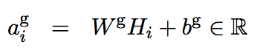
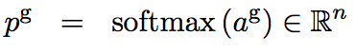
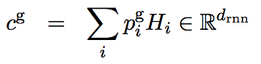
Encoder Module
The global-local self-attention context c is calculated as following:
4)
5)
6)
Notes:
Next, we compute a global-local self-attention context c over H.
Self-attention is an effective method to compute summary context over variable-length sequences for natural language processing tasks.
In this case, we use a global self-attention module to compute an attention context useful for general-purpose state tracking, as well as a local self-attention module to compute a slot-specific attention context.
For each ith element Hi, we compute a scalar global self-attention score agi which is subsequently normalized across all elements using a softmax function.
The global self-attention context cg is then the sum of each element Hi, weighted by the corresponding normalized global self-attention score p gi

Slide 35
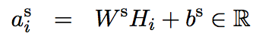
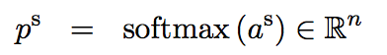
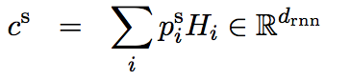
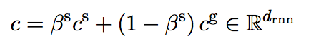
Encoder Module
7)
8)
9)
10)
Notes:
Similarly, we similarly compute the local self-attention context cs.
And finally, the global-local self-attention context c is the mixture.
the scalar beta is a learned parameter between 0 and 1 that is specific to the slot s.
And these are the whole processes of the encoder part of the model.

Slide 36
Scoring Module
Intuitively, two input sources could indicate whether the user has expressed the slot-value pair under consideration.
User utterance
Because User directly states the goals and requests
Previous system actions
Because sometimes user utterance does not present enough information without referring to previous system actions
Notes:
Next, let’s move to the scoring part of the model.
Intuitively, two input sources could indicate whether the user has expressed the slot-value pair under consideration. The first one is user utterance and the second one is previous system actions.
In user utterance, user directly states the goals and requests. An example of this is the user saying “how about a French restaurant in the centre of town?”, after the system asked “how may I help you?”
Previous system actions are also informative when the user utterance does not present enough information and instead refers to previous system actions. An example of this is the user saying “yes”, after the system asked “would you like a restaurant in the centre of town?”

Slide 37
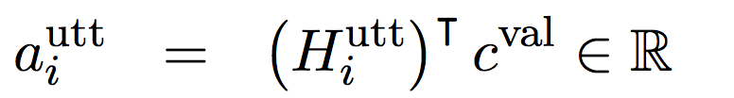
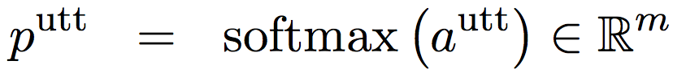
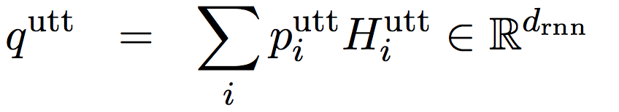
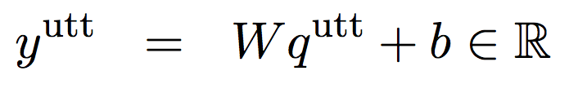
Scoring Module
User utterance
Model attends over the user utterance, taking into account the slot-value pair being considered, and use the resulting attention context to score the slot-value pair.
11）
12）
13）
14）
Notes:
For user utterance, we determine whether the utterance specifies the slot-value pair.
Namely, we attend over the user utterance Hutt, taking into account the slot-value pair being considered cval, and use the resulting attention context qutt to score the slot-value pair.
The calculations are listed on the slides. The score yutt indicates the degree to which the value was expressed by the user utterance.

Slide 38
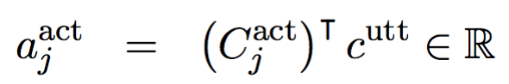
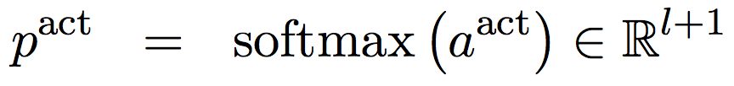
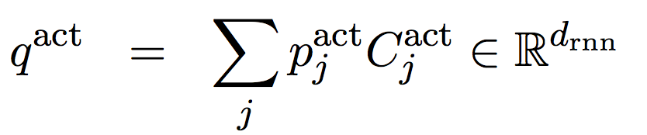
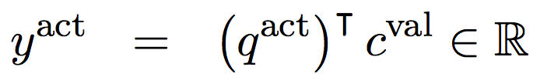
Scoring Module
Previous system action
Firstly, the model attends over previous action representations, taking into account the current user utterance. Then, the model uses the similarity between the attention context and slot-value to score the slot-value pair.
15)
16)
17)
18)
Notes:
To deal with the previous system actions, we examine previous actions after considering the user utterance.
First, we attend over the previous action representations, taking into account the current user utterance cutt.
Then, we use the similarity between the attention context qact and the slot-value pair cval to score the slot-value pair.
The score yact indicates the degree to which the value was expressed by the previous actions.

Slide 39
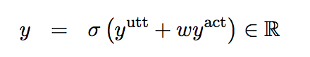
Model
Finally, a sentinel action is introduced to each turn, which allows the attention mechanism to ignore previous system actions.
The final score is then a weighted sum between the utterance score and action score, normalized by the sigmoid function.
Notes:
The final score y is then a weighted sum between the two scores yutt and yact, normalized by the sigmoid function.
Here, the weight w is a learned parameter.

Slide 40
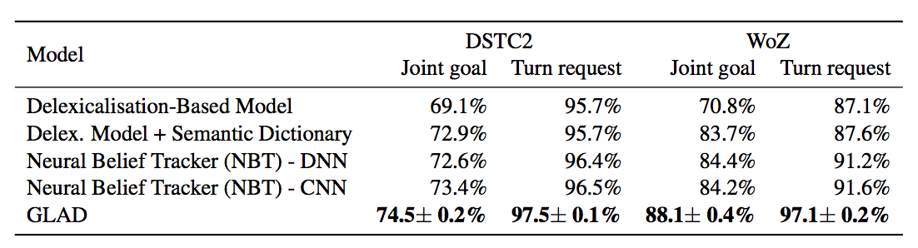
Experimental Results
Table 1: Test accuracies on the DSTC2 and WoZ restaurant reservation datasets. The other models are: delexicalisation DSTC2 (Henderson et al., 2014b), delexicalisation WoZ (Wen et al., 2017), and NBT (Mrksˇic ́ et al., 2017). We run 10 models using random seeds with early stopping on the development set, and report the mean and standard deviation test accuracies for each dataset.
Notes:
Here comes to the experimental results part.
The experiment data set is from The Dialogue Systems Technology Challenges (DSTC) as well as Wizard of Oz, which provides a common framework for developing and evaluating dialogue systems and dialogue state trackers.
Table 1 shows the performance of GLAD compared to previous state-of-the-art models. The delexicalisation models, which replace slots and values in the utterance with generic tags. Semantic dictionaries map slot-value pairs to hand-engineered synonyms and phrases. The NBT applies CNN over word embeddings learned over a paraphrase database.
On the WoZ dataset, we find that GLAD significantly improves upon previous state-of-the- art performance by 3.7% on joint goal tracking accuracy and 5.5% on turn-level request tracking accuracy.
On the DSTC dataset, which evaluates using noisy ASR outputs instead of user utterances, GLAD improves upon previous state of the art performance by 1.1% on joint goal tracking accuracy and 1.0% on turn-level request tracking accuracy.

Slide 41
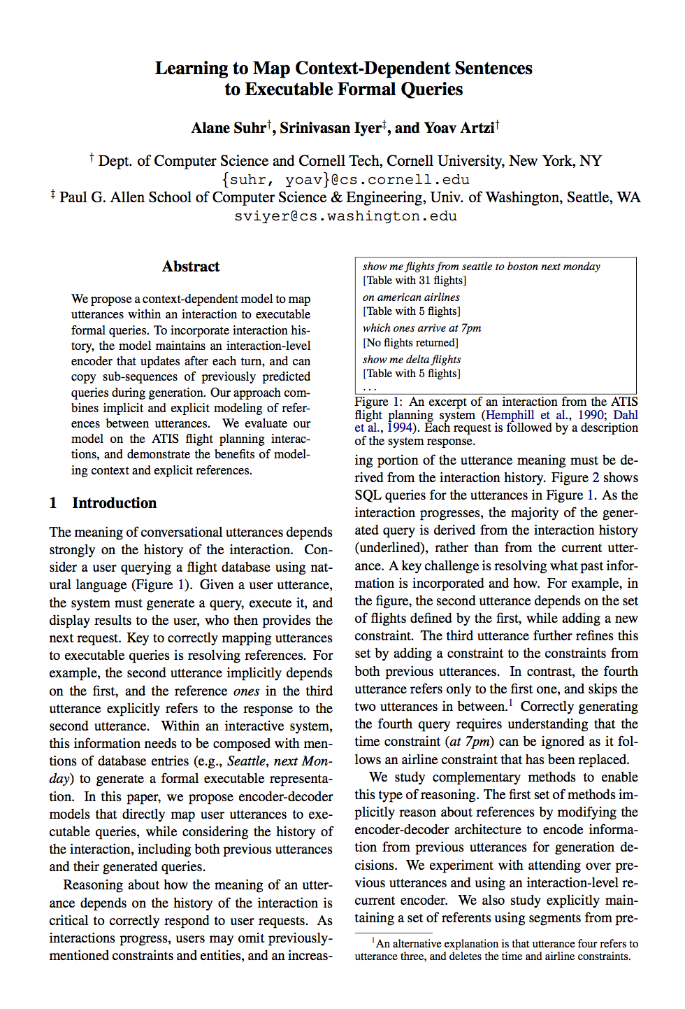
Paper 2: Dialogue to Query
Learning to Map Context-Dependent Sentences to Executable Formal Queries
Alane Suhr, Srinivasan Iyer, and Yoav Artzi (NAACL 2018)
"We propose a context-dependent model to map utterances within an interaction to executable formal queries. To incorporate interaction history, the model maintains an interaction-level encoder that updates after each turn, and can copy sub-sequences of previously predicted queries during generation. Our approach combines implicit and explicit modeling of references between utterances. We evaluate our model on the ATIS flight planning interactions, and demonstrate the benefits of modeling context and explicit references. "
Notes:
Next, let us move to the second paper. "Learning to Map Context-Dependent Sentences to Executable Formal Queries".
This paper concluded some research work on map context dependent sentences to executable formal queries, which is a area related to dialogue systems and semantic parsing.

Slide 42
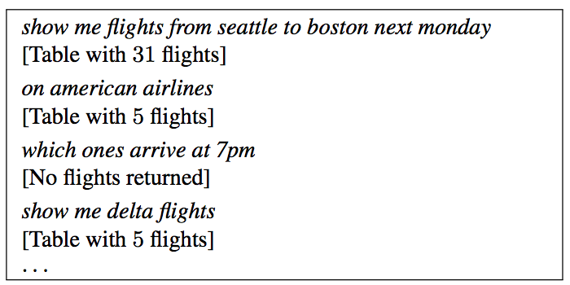
Motivation
Background:
The meaning of the conversational utterance depends strongly on the history of the interaction. Reasoning about how the meaning of an utterance depends on the history is critical to correctly respond to user requests.
Figure X: An excerpt of an interaction from the ATIS flight planning system (Hemphill et al., 1990; Dahl et al., 1994). Each request is followed by a description of the system response.
Notes:
Next, let us move the motivation of this paper. The background of the problem is that, meaning of the conversational utterance depends strongly on the history of the interaction.
Reasoning about how the meaning of an utterance depends on the history is critical to correctly respond to user requests.
And the picture shown here provides an illustration. Here you can see that every time the user provides additional conditions, the system will shrink the number of table so that the result will be more desirable.

Slide 43
Motivation
Proposal:
The goal of this paper is map utterance in interactions to formal executable queries. The encoder-decoder model directly map utterance to executable queries, while considering the history of the interaction, including previous utterances and their generated queries.
Notes:
Therefore, the goal of this paper is to do some work on mapping utterance in interactions to formal executable queries.
The paper propose a encoder-decoder model directly map utterance to executable queries, while considering the history of the interaction, including previous utterances and their generated queries.

Slide 44
Idea
Related Fields and Previous Work:
Semantic Parsing: Mapping sentences to formal representations
Dialogue Systems: Context-dependent language understanding
Model in Paper:
Based on the RNN, encoder-decoder framework with attention.
Attending over previous utterance
Adding a turn-level recurrent encoder to update after each turn
Adding a copying mechanism for previous utterance
Notes:
Many relevant work has been done in related areas before. Mapping sentence in isolation to SQL queries has been studied by using both statistical parsing and sequence-to-sequence models.
And context-dependent language understanding was also studied for dialogue systems. And encoder-decoder methods were applied to dialogue systems.
The idea or model proposed in this paper is based on the RNN framework with attention. And the model is modified to reason about context from the interaction history, namely attending over previous utterances, adding a turn-level recurrent encoder that updates after each turn, and adding a mechanism to copy segments of queries from previous utterances.

Slide 45
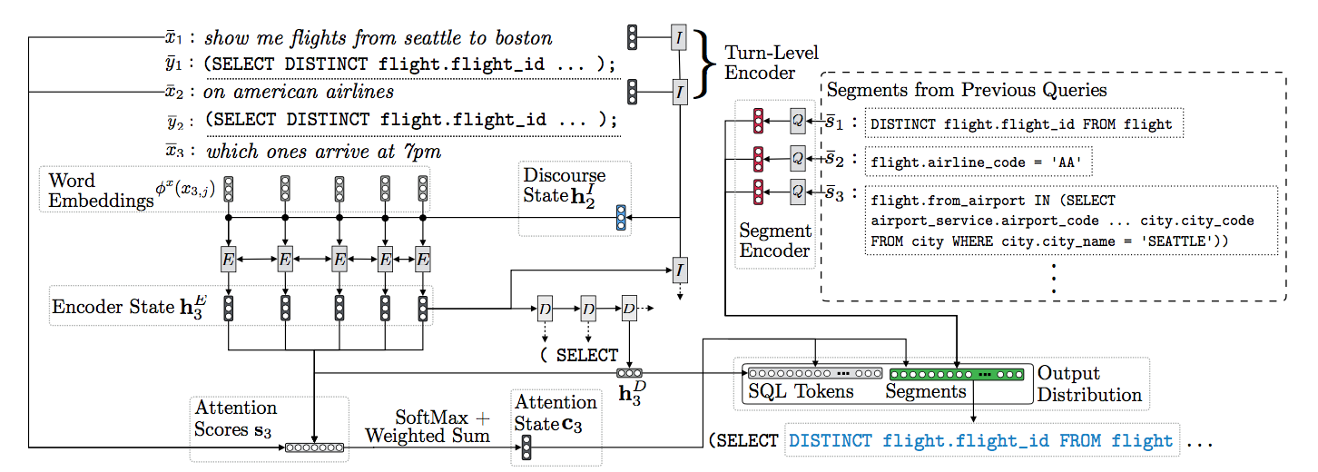
Model
Figure 3: Illustration of the model architecture during the third decoding step while processing the instruction which ones arrive at 7pm from the interaction
Notes:
Next, let us have a look at the model proposed on this paper. And this picture is an overview of the model.
Currently, the model is processing "Which one arrives at 7 p.m. ?" The previous discourse state h2I is used to encode the current utterance x3.
Query segments from the previous queries are encoded into vector representation.
In each generation step, the decoder attends over the previous and current utterance, and a probability distribution is computed over SQL tokens and query segments. Here, segment is "select"

Slide 46
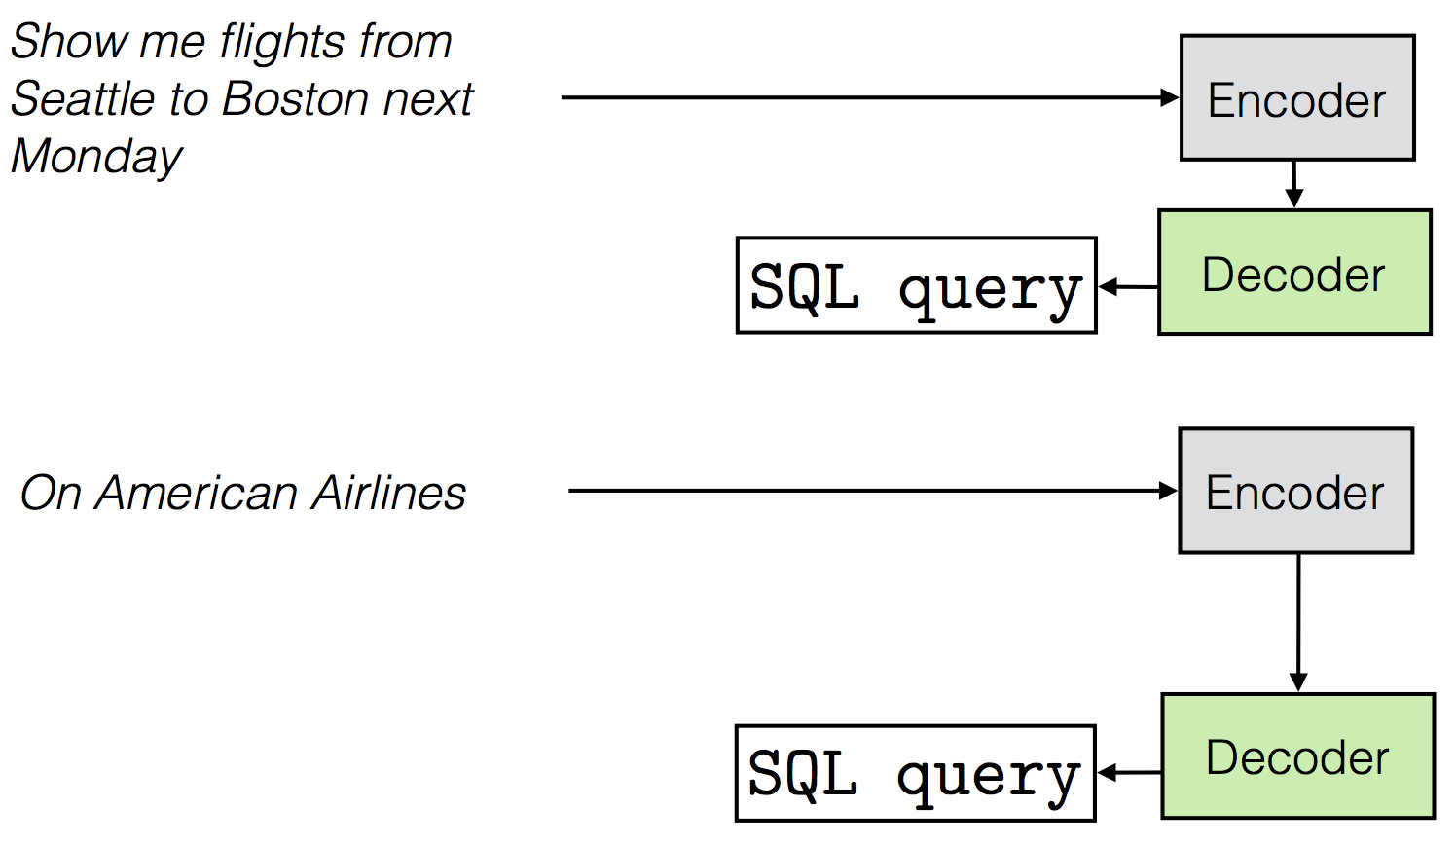
Model
Encoder-Decoder Architecture
An encoder to process the user utterance and a decoder to generate the output query token-by-token.
Notes:
Firstly, as mentioned above, let’s begin with the encoder-decoder module to look at the model. In the model, an encoder is used to process the user utterance and the decoder is used to generate the output query token by token.
The encoder compute a hidden state for each token using a bi-directional LSTM. And the decoder is also based on the LSTM network.

Slide 47
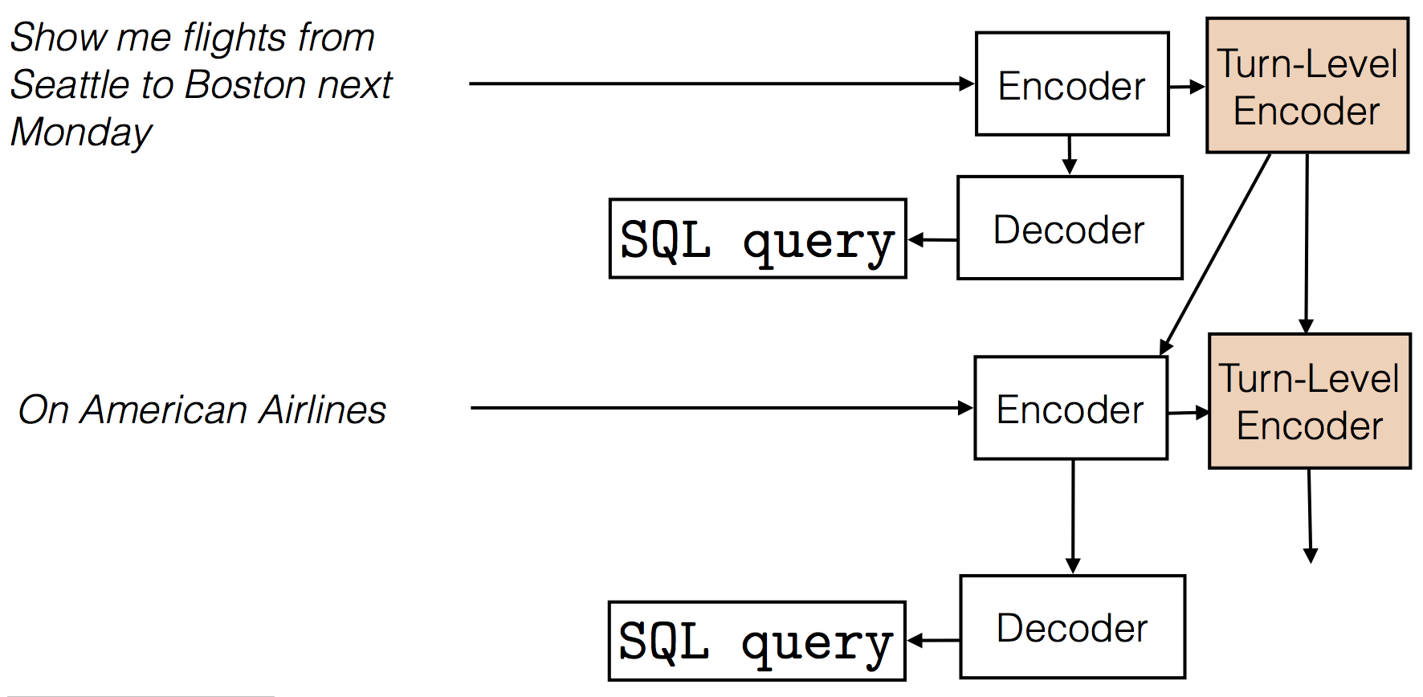
Model
Mechanism One
Turn level encoder is proposed to deal with previous requests
Notes:
Next, let us look at the mechanism that is used to modify the model.
The first one is adding a turn-level recurrent encoder that updates each turn.
To account for the influence of the interaction history on utterance encoding, we maintain a discourse state encoding computed with a turn-level recurrence, and use it during utterance encoding.
The state is maintained and updated over the entire interaction.

Slide 48
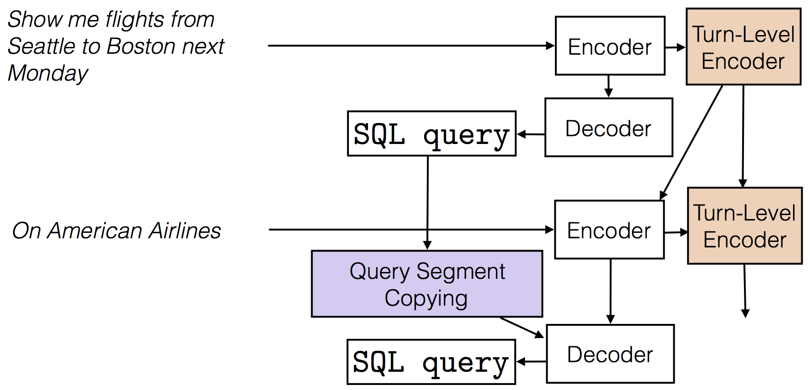
Model
Mechanism Two
Query Segment Copying
Notes:
And the second one is to copy segments of queries from previous utterances.
The discourse state and attention over previous utterances allow the model to consider the interaction history when generating queries.
However, we observe that context-dependent reasoning often requires generating sequences that were generated in previous turns.

Slide 49
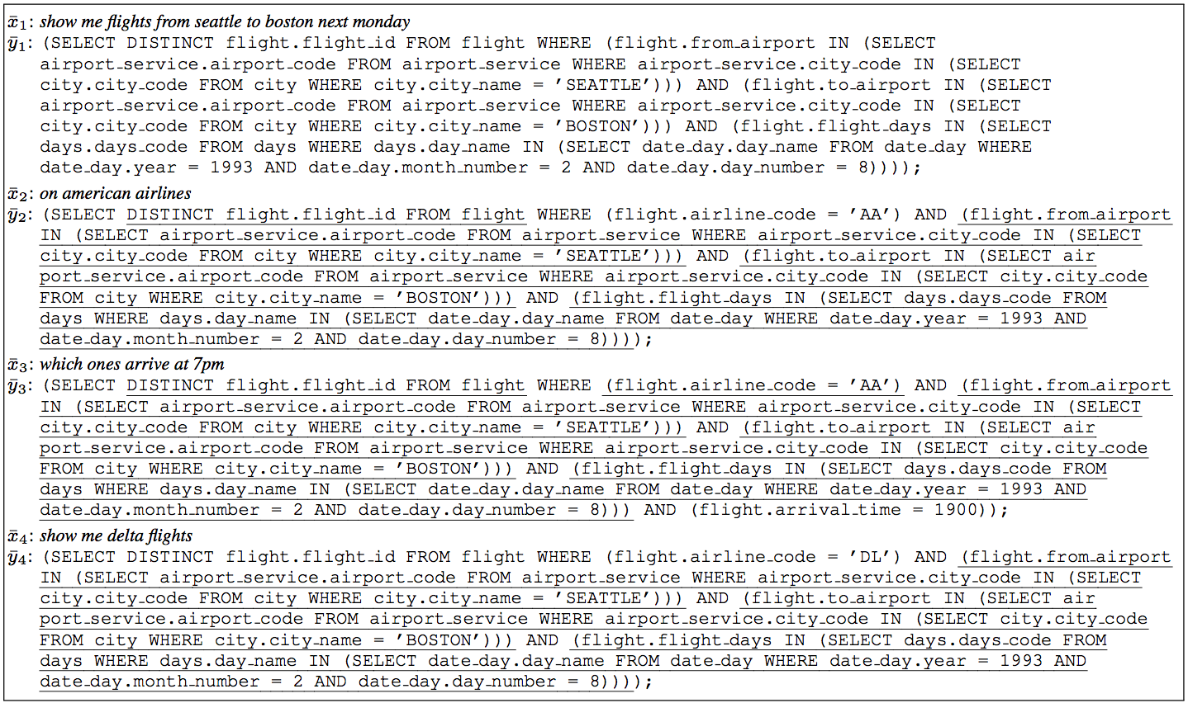
Model
Mechanism Two
Notes:
This picture shows how segments (which are underlined) extracted from previous utterances are predominant in later queries.
To take advantage of what was previously generated, we add copying of complete segments from previous queries by expanding the set of outputs at each generation step.
This mechanism explicitly models references, reduces the number of steps required to generate queries, and provides an interpretable view of what parts of a query originate in context.

Slide 50
Model
Inference
Show me flights from Seattle to Boston next Monday
Encoder
Turn-Level
Encoder
Notes:
And next, I will go through the model to show how it works.
An interaction starts with the user providing the first utterance “Show me flights from Seattle to Boston next Monday”. Then it is input into the encoder to be encoded and the discourse state is calculated by the turn-level encoder

Slide 51
Model
Inference
Show me flights from Seattle to Boston next Monday
Encoder
Turn-Level
Encoder
SQL Query
Decoder
Notes:
Then the query is generated by the decoder, and the set of SQL segments is created.
The user then provides the next utterance or concludes the interaction.

Slide 52
Model
Inference
Show me flights from Seattle to Boston next Monday
Encoder
Turn-Level
Encoder
SQL Query
Decoder
On American Airlines
Encoder
Notes:
The next user utterance is then encoded using the previous discourse state.

Slide 53
Model
Inference
Show me flights from Seattle to Boston next Monday
Encoder
Turn-Level
Encoder
SQL Query
Decoder
On American Airlines
Encoder
Turn-Level
Encoder
Query Segment Copying
SQL Query
Decoder
Notes:
Then the current discourse state is computed.
The query is generated using the set of previous query segments, which is generated by the Query Segment Copying mechanism.
The model has no access to future utterances.

Slide 54
Show me flights from Seattle to Boston next Monday
Encoder
Turn-Level
Encoder
SQL Query
Decoder
On American Airlines
Encoder
Turn-Level
Encoder
Query Segment Copying
SQL Query
Decoder
Notes:
Then the current discourse state is computed.
The query is generated using the set of previous query segments, which is generated by the Query Segment Copying mechanism.
The model has no access to future utterances.

Slide 55
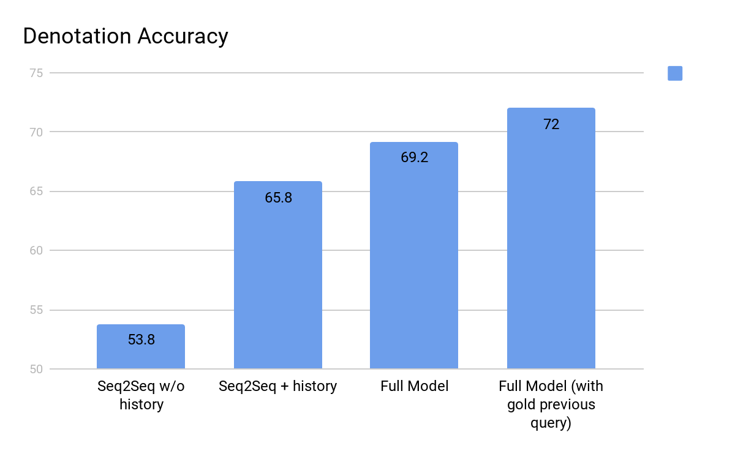
Experimental Results
Using interaction history is critical
Notes:
Here comes the experiment results of the model.
Four kinds of systems are chosen to be evaluated.
The first one is seq2seq baseline encoder-decoder model.
The second one is encoder-decoder with attention on current and previous utterances.
The third one is full model with complete approach including segment copying but without attention on previous utterances.
The fourth one is also a full model evaluated with predicted and gold previous queries.
Results show that attending on recent history significantly increases performance.
The best performance is achieved by the full model evaluated by predicted and gold previous queries. And Error propagation contributes about 3% performance drop.

Slide 56
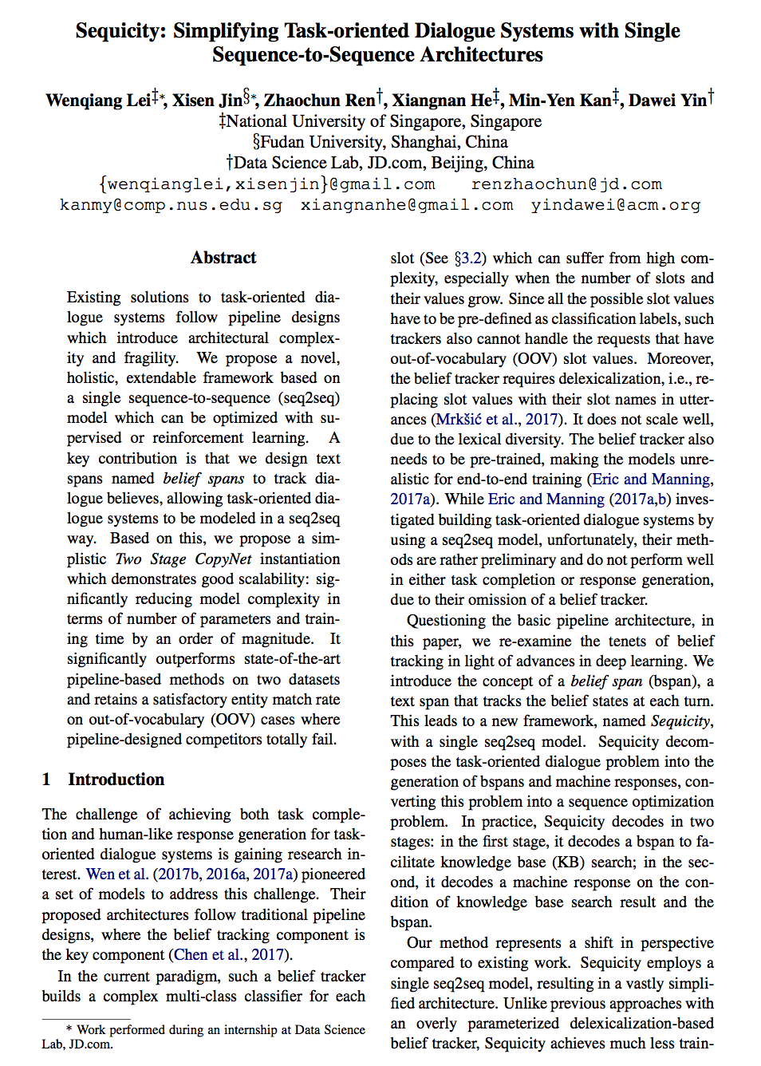
Paper 3: Sequicity: Simplifying Task-oriented Dialogue Systems with Single Sequence-to-Sequence Architectures
Sequicity: Simplifying Task-oriented Dialogue Systems with Single Sequence-to-Sequence Architectures
Qianlong Liu, Zhongyu Wei, Baolin Peng, Xiangying Dai, Huaixiao Tou, Ting Chen, Xuanjing Huang, Kam-fai Wong (ACL 2018)
"In this paper, we make a move to build a dialogue system for automatic diagnosis. We first build a dataset collected from an online medical forum by extracting symptoms from both patients’ self-reports and conversational data between patients and doctors. Then we propose a task- oriented dialogue system framework to make the diagnosis for patients automatically, which can converse with patients to collect additional symptoms beyond their self-reports. Experimental results on our dataset show that additional symptoms extracted from conversation can greatly improve the accuracy for disease identification and our dialogue system is able to collect these symptoms automatically and make a better diagnosis. "
Notes:
Next, let us move to the third paper. “Sequicity: Simplifying Task-oriented Dialogue Systems with Single Sequence-to-Sequence Architectures”
This paper concluded some research work on proposing a seq2seq framework.
A key contribution is that they design text spans named belief spans to track dialogue believes, allowing task-oriented dialogue systems to be modeled in a seq2seq way. Based on this, they propose a simplistic Two Stage CopyNet instantiation which demonstrates good scalability: significantly reducing model complexity in terms of number of parameters and training time by an order of magnitude.

Slide 57
Motivation
Background:
Existing solutions to task-oriented dialogue systems follow pipeline designs which introduce architectural complexity and fragility.
Proposal:
A framework, named Sequicity, which decomposes the task-oriented dialogue problem into the generation of bspans and machine responses, converting this problem into a sequence optimization problem.
Notes:
Next, let’s move to the motivation of this paper. The background is that existing solutions to task-oriented dialogue systems follow pipeline designs which introduce architectural complexity and fragility.
Therefore, in this paper, the authors propose to develop a framework, named Sequicity, which decomposes the task-oriented dialogue problem into the generation of bspans and machine responses, converting this problem into a sequence optimization problem.

Slide 58
Idea
Related Fields and Previous Work:
Historically, task-oriented dialog systems have been built as pipelines of separately trained modules:
1) a user intent classifier 2) a belief tracker
3) a dialogue policy maker 4) response generator
Contribution in Paper:
A novel, extendable framework based on a single sequence-to-sequence (seq2seq) model which can be optimized with supervised or reinforcement learning.
Notes:
Previous related work has been done in this area before. Historically, task-oriented dialog systems have been built as pipelines of separately trained modules:
1) a user intent classifier 2) a belief tracker
3) a dialogue policy maker 4) response generator
And in this paper, a extendable framework based on a single sequence-to-sequence model which can be optimized with supervised or reinforcement learning.

Slide 59
Method
Belief Spans for Belief Tracking
The core of belief tracking is keeping track of informable and requestable slot values when a dialogue progresses.
In contrast to the work which treats slot values as classification labels, Belief Spans leverage the state-of-the-art neural seq2seq models to learn and dynamically generate them.
Use an informative field (<Inf> </Inf>) to store values of informable slots.
Notes:
So let us look at the brief span proposed in this paper. The core of belief tracking is keeping track of informable and requestable slot values when a dialogue progresses.
In the era of pipeline-based methods, supervised classification is a straightforward solution.
In contrast to the previous work, belief spans leverage the state-of-the-art neural seq2seq models to learn and dynamically generate them.
And a belief span has an information field (marked with <Inf></Inf>) to store values of informable slots since only values are important for knowledge base search.

Slide 60
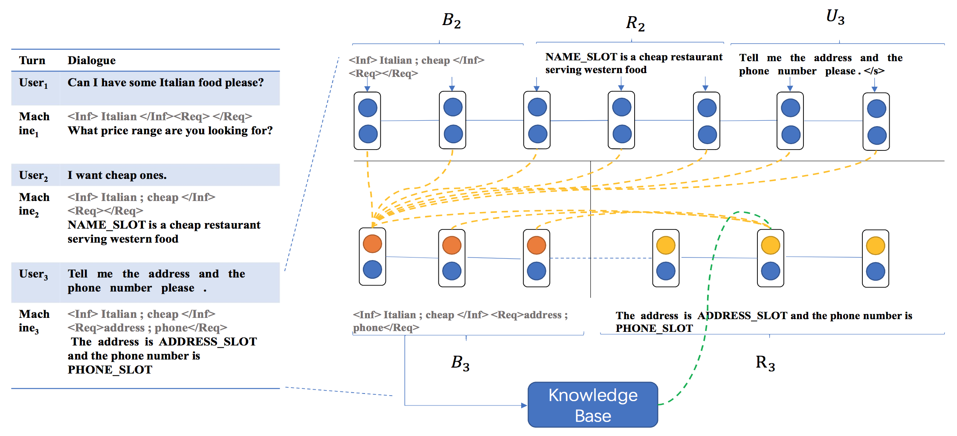
Method
Belief Spans for Belief Tracking
Figure 1: Sequicity overview.
Notes:
This picture is an overview of the Sequicity Framework.
The left shows a sample dialogue; the right illustrates the Sequicity. Bt is employed only by the model, and not visible to users.
At turn t, given the user utterance Ut, we show an example of both span Dt and machine response Rt generation in the figure, where annotated slot values at each turn are decoded into spans.
B1 contains an information slot "Italian" because the user stated 'Italian food' in U1. During the second turn, the user adds an additional constraint 'cheap' resulting in two slot values in B2 information field.
In the third turn, the user further asks for the restaurant's phone and address, which are stored in requested slots of B3.

Slide 61


Method
The Sequicity Framework
At turn t, a system needs to refer to Bt−1, Rt−1 and Ut to generate a new belief span Bt and machine response Rt, without appealing to knowing all past utterances.
Such Markov assumption allows Sequicity to concatenate Bt−1, Rt−1 and Ut (denoted as Bt−1 Rt−1 Ut ) as a source sequence for seq2seq modeling, to generate Bt and Rt as target output sequences at each turn.
Notes:
Here, the authors make a key observation and assumption here, which is at turn t, a system only needs to refer to Bt 1, Rt 1 and Ut to generate a new belief span Bt and machine response Rt, without appealing to knowing all past utterances.
Such Markov assumption allows Sequicity to concatenate Bt−1, Rt−1 and Ut (denoted as Bt−1 Rt−1 Ut ) as a source sequence for seq2seq modeling, to generate Bt and Rt as target output sequences at each turn.
In this way, Sequicity fulfills both task accomplishment and response generation in an unified seq2seq model.
Note that, we process Bt and Rt separately, as the belief state Bt depends only on Bt 1 Rt 1 Ut , while the response Rt is additionally conditioned on Bt and the knowledge base search results (denoted as kt); that is, Bt informs the Rt’s contents.

Slide 62
Method
Sequicity Instantiation: A Two Stage CopyNet
Denote the first m0 tokens of target sequence Y are Bt and the rests are Rt, i.e. Bt = y1...ym0 and Rt = ym0+1...ym
Improve upon CopyNet (Gu et al., 2016) as seq2seq model
CopyNet (Gu et al., 2016) enlarges the decoding output space from V to V and X, where V is the output of traditional decoder
Notes:
Next, let’s look at how to instantiate the sequicity. We term our instantiated model a Two Stage CopyNet (TSCP)
We denote the the first m0 tokens of target sequence Y are Bt and the rests are Rt
The instantiated model choose to improve upon CopyNet as a new seq2seq model.
This is a natural choice as we observe that target sequence generation often requires the copying of tokens from the input sequence.
From a probabilistic point of view, the traditional encoder–decoder structure learns a language model. To decode yj, we can employ a softmax to calculate the probability distribution over output space V and then choose the token with the highest generation probability.
However, in our case, tokens in the target sequence Y might be exactly copied from the input X, such as a word of food style. These copied words need to be explicitly modeled. CopyNet is a natural fit here, as it enlarges the decoding output space from V to V and X .

Slide 63

Method
Sequicity Instantiation: A Two Stage CopyNet
Employ two separate RNN in decoder: one for Bt and the other for Rt
First decoding stage, copy probability for each word v from X
Second decoding stage (decoding Rt), apply copying mechanism on Bt instead of X
Notes:
In Sequicity, simply applying original CopyNet architecture is insufficient, since Bt and Rt have different distributions.
We here employ two separate RNN (GRU in our implementation) in decoder: one for Bt and the other for Rt.
In the first decoding stage, we have a copy-attention mechanism on X to decode Bt; then calculate the generation probability through attending to X, as well as the copy probability for each word v belong to X.
In the second decoding stage (i.e., decoding Rt), we apply the last hidden state of Bt as the initial hidden state of the Rt GRU. However, as we need to explicitly model the dependency on Bt, we have copy-attention mechanism on Bt instead of on X: treating all tokens of Bt as the candidate for copying and attention.

Slide 64

Experimental Results
On KVRET dataset
Model size sensitivity with respect to KVRET.
Notes:
Traditional belief trackers are built as a multiclass classifier, which models each individual slot and its corresponding values, introducing considerable model complexities. This is especially severe in datasets with a large number of slots and values. In contrast, Sequicity reduces such a complex classifier to a language model.
To compare the model complexities of two approaches, we empirically measure model size. We here selectively present TSCP, NDM and its separately trained belief tracker.
NMD adopts pipeline designs with a belief tracker component depending on delexicalization.
A belief tracker builds a complex multi-class classifier for each slot which can suffer from high complexity, especially when the number of slots and their values grow.
As shown in Figure, TSCP has a magnitude less number of parameters than NDM and its model size is much less sensitive to distinct slot values increasing. It is because TSCP is a seq2seq language model which has an approximate linear complexity to vocabulary size.

Slide 65

Paper 4: End-to-End Learning of Task-Oriented Dialogs
End-to-End Learning of Task-Oriented Dialogs
Bing Liu, Ian Lane (NAACL 2018)
"In this thesis proposal, we address the limitations of conventional pipeline design of task oriented dialog systems and propose end-to-end learning solutions. We design neural network based dialog system that is able to robustly track dialog state, interface with knowledge bases, and incorporate structured query results into system responses to successfully complete task-oriented dialog. In learning such neural network based dialog systems, we propose hybrid offline training and online interactive learning methods. We introduce a multi-task learning method in pre-training the dialog agent in a supervised manner using task-oriented dialog corpora. The supervised training agent can further be improved via interacting with users and learning online from user demonstration and feedback with imitation and reinforcement learning. In addressing the sample efficiency issue with online policy learning, we further propose a method by combining the learning-from-user and learning from-simulation approaches to improve the online interactive learning efficiency."
Notes:
The fourth paper presented today is “End-to-End Learning of Task-Oriented Dialogs”. In this paper, authors address the limitations of conventional pipeline design of task-oriented dialog systems and propose end-to-end learning solutions.

Slide 66
Motivation
Background:
Pipeline task-oriented dialogue system design has a number of limitations.
Credit assignment can be challenging, as errors made in upper stream modules may propagate and be amplified in downstream components.
Each component in the pipeline is ideally re-trained as preceding components are updated, so that we have inputs similar to the training examples at run-time.
Notes:
The motivation of this paper is to propose an end-to-end model to address the limitations of pipeline dialog systems and learning solutions.
Some of the limitations are:
Credit assignment can be challenging, as errors made in upper stream modules may propagate and be amplified in downstream components.
Each component in the pipeline is ideally re-trained as preceding components are updated, so that we have inputs similar to the training examples at run-time.

Slide 67
Motivation
Proposal
Proposed end-to-end model to address the limitations of pipeline dialog systems and learning solutions.
The proposed model is capable of robustly tracking dialog state, interfacing with knowledge bases, and incorporating structured query results into system responses to successfully complete task-oriented dialog.
Notes:
So, this paper proposed to design neural network based dialog system that is able to robustly track dialog state, interface with knowledge bases, and incorporate structured query results into system responses to successfully complete task-oriented dialog.

Slide 68

Idea
Related Fields and Previous Work:
Pipeline architecture for dialogue systems
End-to-end Dialogue Model [Wen et al., 2017]
Figure 1: Pipeline architecture for spoken dialog systems
Notes:
There are many previous work related to this area.
The figure shown on the slide shows a typical pipeline architecture of task-oriented spoken dialog system.
Transcriptions of user’s speech are firstly passed to the SLU module, where the user’s intention and other key information are extracted.
This information is then formatted as the input to DST, which maintains the current state of the dialog.
Outputs of DST are passed to the dialog policy module, which produces a dialog act based on the facts or entities retrieved from external resources (such as a database or a knowledge base).
The dialog act emitted by the dialog policy module serves as the input to the NLG, through which a natural language format system response is generated.
In this thesis work, the authors propose end-to-end solutions that focus on three core components of task-oriented dialog system: SLU, DST, and dialog policy.
Conventional task-oriented dialog systems use a pipeline design by connecting the above core system components together.
Such pipeline system design makes it hard to track source of errors and align system optimization targets.
To solve these limitations, researchers have recently started exploring end-to-end solutions for task-oriented dialogs.
Wen et al. proposed an end-to-end trainable neural dialog model in 2017.

Slide 69

Idea
Ideally, the dialog agent should not only be able to passively receive signals from the environment (i.e. the user) and learn to act on it, but also to be able to understand the dynamics of the environment and predict the changes of the environment state.
Proposed task-oriented dialog learning framework
Notes:
Based on the previous work, authors of this paper propose to build a dialog agent that should not only be able to passively receive signals from the environment (i.e. the user) and learn to act on it, but also to be able to understand the dynamics of the environment and predict the changes of the environment state.
This figure shows the proposed learning framework for task-oriented dialog. The dialog agent interacts with user in natural language format and improves itself with the received user feedback.
The dialog agent also learns to interface with external resources, such as a knowledge base or a database, so as to be able to provide responses to user that are based on the facts in the real world.
Inside the dialog agent, the agent learns to model the user dynamics by predicting their behaviors in conversations.
Such modeled user or simulated user in the agent’s mind can help the agent to simulate dialogs that mimic the conversations between the agent and a real user.
By “imagining” such conversations and learning from it, the agent can potentially learn more effectively and reduce the number of learning cycles with real users.

Slide 70

Model
End-to-end task-oriented dialog system architecture
Notes:
This figure shows the architecture of the proposed end-to-end task-oriented dialog system. They use a hierarchical LSTM to model a dialog with multiple turns.
The lower level LSTM, which we refer to as the utterance-level LSTM, is used to encode the user utterance. The higher- level LSTM, which we refer to as the dialog-level LSTM, is used to model a dialog over a sequence of turns.
User input to the system in natural language format is encoded in a continuous vector form via the utterance-level LSTM. The LSTM outputs can be fed to SLU decoders such as an intent classifier and a slot filler.
We may use such SLU module outputs as input to the state tracker. Alternatively, we may directly use the continuous representation of user’s utterance without passing it through a semantic decoder.
The encoded user utterance, together with the encoding of the previous system turn, is connected to the dialog-level LSTM.
State of this dialog-level LSTM maintains a continuous representation of the dialog state.
Based on this state, the belief tracker generates a probability distribution over candidate values for each of the tracked goal slots.
A query command can then be formulated with the belief tracking outputs and sent to a database to retrieve requested information.
Finally, the system produces an action by combining information from the dialog state, the belief tracking outputs, and the encoding of the query results.
This system dialog action, together with the belief tracking output and the query results, is used to generate the final natural language system response via a natural language generator.
All system components are connected via differentiable operations, and the entire system (SLU, DST, and policy) can thus be optimized end-to-end.

Slide 71
Model
Spoken Language Understanding (SLU) and Utterance Modeling
A bidirectional LSTM reader is used to encode the user utterance
LSTM state output is used for slot label prediction
A weighted average of these LSTM state outputs is further used as the representation of the utterance for user intent prediction
Notes:
Therefore, for Spoken Language Understanding (SLU) and Utterance Modeling part, a bidirectional LSTM reader is used to encode the user utterance. The outputs of this LSTM state is used for slot label prediction.
And then weighted average of these LSTM state outputs is further used as the representation of the utterance for user intent prediction

Slide 72
Model
Dialogue Modeling with Hierarchical LSTM
Extend the LSTM based SLU models by adding a higher level LSTM on top to model dialog context over multiple turns
Lower level bidirectional LSTM encode natural language utterance
Upper level bidirectional LSTM models dialog context and produces a probability distribution over candidate values for each of the tracked goal slots
Notes:
This work model the dialogue using a hierarchical LSTM.
The LSTM for SLU modules is extended by adding a higher level LSTM on top to model dialog context over multiple turns
Lower level bidirectional LSTM encode natural language utterance
Upper level bidirectional LSTM models dialog context and produces a probability distribution over candidate values for each of the tracked goal slots

Slide 73
Conclusion
We have covered
Basic Concepts & Motivation of Dialogue Systems
Categories of Dialogue Systems
Task-Oriented Dialogue Systems
Dialogue Understanding and Dialogue to Query
Future Research Direction: Task-Oriented Dialog-to-SQL
Notes:
Now let’s make a brief conclusion of today’s presentation.
Firstly, I introduce some basic concepts and motivation of the dialogue systems.
Then, I introduce the categories of the current dialogue systems and the research work in the dialogue system area.
Finally, I introduce four papers that cover the topics of Task-oriented dialogue systems, dialogue understanding and dialogue to query.
Based on the preparation of this presentation, I propose to a do some research work in the area of the dialogue2sql.

Slide 74
Discussion for Class
What else do you think is important for building dialogue systems or improve the performance of agents?
Other interesting and useful applications?
What other research area will be related to Dialogue Systems ?
Any other related future research directions?
Notes:
Here are some discussion questions. The first one is:
The second one is:
The third one is:

Slide 75
References (other than images)
Papers:
Neural Approaches to Conversational AI Question Answering, Task-Oriented Dialogue and Chatbots: A Unified View
A Survey on Dialogue Systems: Recent Advances and New Frontiers
A Network-based End-to-End Trainable Task-oriented Dialogue System
End-to-End Learning of Task-Oriented Dialogs
Task-oriented Dialogue System for Automatic Diagnosis
Sequicity: Simplifying Task-oriented Dialogue Systems with Single Sequence-to-Sequence Architectures
A Survey of Task-oriented Dialogue Systems
GUS, A frame driven dialog system

Slide 76
Thanks!
Q&A

